Slide 1

CS2033a/b
Multimedia and Communications II
Lecture #1
Introduction
Vivi Tryphonopoulos

Slide 2
Lecture 1 overview
GOAL: 1 HR
Introduction
  Find out about the Lecturer
  Intro to the course - So what’s this course all about?
What do you need to purchase
  Required Software
Course Syllabus (on owl)
  Where to find weekly course info
  Labs vs. Lectures
  Software
  Office Hours
  Assignment Due Dates
  Mark Evaluations

Slide 3
Course Information
http://owl.uwo.ca
EVERYTHING you need!
    Lecture Notes
    Lab Handouts
    Assignments
    Announcements
    FAQs section - IMPORTANT

Slide 4

Course Etiquette
Mondays (Section 002) -- only one section
9:30 am – 11:30 am TC-141
  Vivi Tryphonopoulos
    Office: MC 366
    Office Hours: email me or set up an appointment
    Email: vtryphon@uwo.ca
  The best way to contact me is via email:
    Use your uwo email account – not your gmail
    Make sure you put CS2033 in the subject line
        Ie. CS2033 - Card swipe doesn’t work
        Ie. CS2033 - My computer got stolen
        DO NOT SEND ME: A ZIPPED FILE, NOR YOUR FILES UNLESS i ASK FOR THEM... You make my mailbox overfill
        Also check your mailbox in case it is full
    I may email the entire class sometimes in emergency situations - check your uwo email at least every 24 hours (check spam folder )
  Check the Announcements on Owl Sakai

Slide 5

Course Prerequisite
CS 1033 is a Must!
So how well do you know the software
Photoshop?
Dreamweaver?
File Transfer Program (WinSCP, Filezilla, Fugu)?
CSS Box model concepts
Blogs
RSS Feeds
Google Analytics

Slide 6
Course Etiquette
Mondays (Section 002) -- only one section
9:30 pm – 11:30 pm Talbot 141
  Vivi Tryphonopoulos
    Office: MC 366
    Office Hours: email me or set up an appointment
    Email: vtryphon@uwo.ca
  The best way to contact me is via email:
    Use your uwo email account – not your gmail
    Make sure you put CS2033 in the subject line
        Ie. CS2033 - Card swipe doesn’t work
        Ie. CS2033 - My computer got stolen
        DO NOT SEND ME: A ZIPPED FILE, NOR YOUR FILES UNLESS i ASK FOR THEM... You make my mailbox overfill
        Also check your mailbox in case it is full
    I may email the entire class sometimes in emergency situations - check your uwo email at least every 24 hours (check spam folder )
  Check the Announcements on Owl

Slide 7
What will I learn?
Lectures vs Labs
Lectures
Labs (total 10 labs)
Concepts
Advanced Image Processing
Websites- using CSS
Form creation & processing
Blogs, RSS Feeds
SEO–google analytics,payperclicks
Online shopping – paypal, ecommerce
Designing for handheld devices
SOFTWARE
  Server & File Transfer (1)
  Photoshop Advanced (2)
  Dreamweaver – CSS, Templates, library, dropdown menus(3)
  Forms (1)
  Blogs & RSS Feeds (1)
  Image – fadein/fadeout (1)
  Last Lab - e-commerce etc.

Slide 8
What do you need to purchase?
Perhaps nothing ☺ (see next slide for prices)
No textbook
Lecture notes are available on the website OWL Sakai
Software (CS6 suite) is available in MC235 and NC105
North Campus Building also has DW and Photoshop See schedule
Software to be used:
    Photoshop CS6 or Creative Cloud
    Dreamweaver CS6
Everything else will be FREE:
  WinSCP (PC File Transfer) (available from ITS - FREE)
  And anything else needed will be free

Slide 9
What will I need to buy?
Photoshop and Dreamweaver needed for the course
You can get free 30-day trial versions for 1 month of Photoshop and Dreamweaver (BUT IF YOU ALREADY DOWNLOADED TRIAL cs6 BEFORE IT WILL NOT ALLOW YOU)
Our labs have CS6
Our labs are open 24/7 as long as there is no class being conducted in them. You need your student card to get into the MC building and into the lab rooms. (North entrance of the building)
Consider buying from Adobe site:
    See next slide
    Buy single application for $29.95 U.S. on a monthly basis

Slide 10
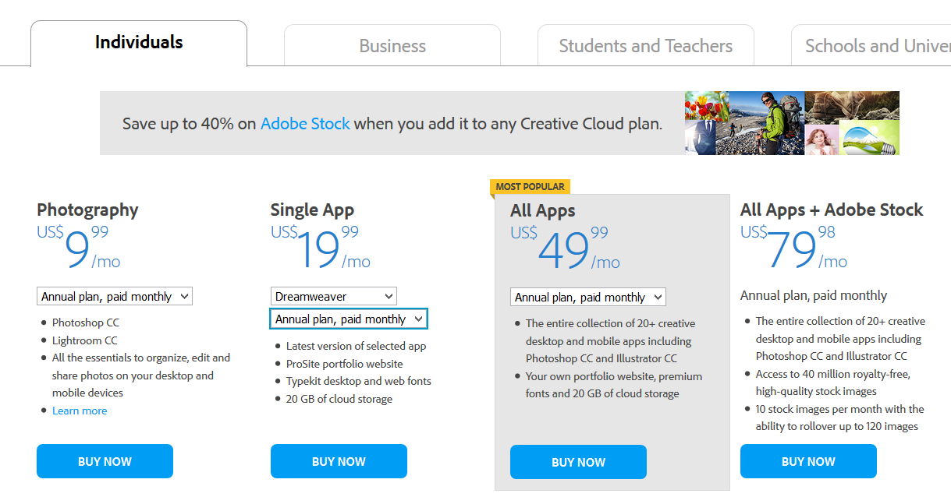
What will I need to buy?
Consider buying from Adobe site:
https://creative.adobe.com/plans?promoid=KLXMK
    Buy single application for $29.95 U.S. on a monthly basis
    Photoshop (pace yourself for Assignment 1)
    Dreamweaver only (for Assignment2 and Assignment 3)
You buy jan.5..
You cancel by Feb. 4th and thus only pay one month
So plan according to what is necessary for you

Slide 11
Your course grade
READ THE COURSE SYLLABUS, it is a contract between you and me!
YOUR GRADE
Labs → 10%
Assignments
  Assignment 1 → 10 %
  Assignment 2 → 15 %
  Assignment 3 → 25 %
Exam → 40%
TOTAL
MARK
100%
(but be careful there are conditions to pass )

Slide 12
Lectures
Make sure you come to classes, notes will be incomplete ON PURPOSE
Consulting
Each of our Teaching assistants will be available for consulting
Consulting by teaching assistants is done in
MC 4, please notify me if the TA is missing!
Consulting Schedule will be posted on course website (OWL)
Try the TA to troubleshoot your problem...
If you need an appointment with me, email me.

Slide 13
Labs
LABS BEGIN WEEK OF January 11th
Need your student card to open the door to the labs
Lab attendance is mandatory
You MUST attend the lab you registered for, you may NOT switch labs during the term.
Labs 1-9 are worth 1% each
Lab 10 is worth 2% ( don’t miss lab 10 if you missed another one)
Lab marks add up to 11, you will get either 10 or the total of all your lab marks, which ever is lower.
Your lab mark will be updated every week in OWL Sakai by your teaching assistant.
You can not make up a lab, that is why we mark it out of 10, so you have a bit of wiggle room in case you are sick one week!

Slide 14
Labs and your gaul account
YOU WILL BE GETTING A GAUL ACCOUNT
Allows you to get on the lab machines…
  To do your labs
  To work on Assignments using the software
It will be emailed to you prior to lab – check spam folder
DO NOT CHANGE THE PASSWORD!
IF YOU DON’T get the gaul account before your lab…
Show up anyways!
TAs will have guest account for you
See the FAQ section for what to do..

Slide 15





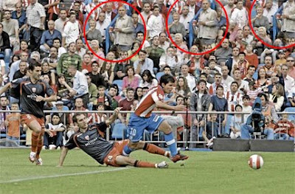


Assignments
Assignment 1 → Creating a poster and applying many of
the special advanced Photoshop techniques

Slide 16
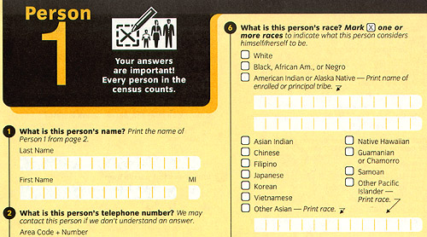
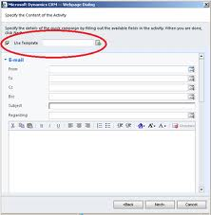
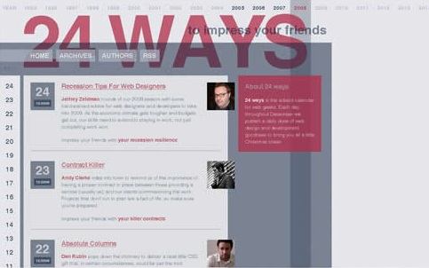
Assignments
Assignment 2 → Design a form and processing it (Dreamweaver)
– perhaps start building your blog

Slide 17



Assignments
Assignment 3 →(Dreamweaver, Photoshop)
Design a website for a given scenario using
Templates, Library items, Blogs, paypal , photogallery, RSS Feed etc.

Slide 18
Assignment Late Policy
Students will lose 15% off the assignments grade for each day it is late. Thus an assignment that is 2 days late and was marked at 85% would receive 55%
Saturday and Sunday count as 1 day
No assignments more than 3 days late will be accepted
NO EXTENSIONS WILL BE GIVEN FOR ASSIGNMENTS unless instructed by the students dean’s office.

Slide 19
Assignment Submissions
You will be using Owl to submit your assignment online
Owl records the date and time you hand in the assignment. Even 1 minute late is LATE ☹
You will get an email from Owl when your assignment has been received. SAVE THIS EMAIL!
The teaching assistant will return your assignment mark breakdown sheet to you via Owl (it will be an .xls document) after he/she has marked your assignment. READ YOUR MARK BREAKDOWN SHEET
Remarks are for the entire assignment, not just the section you request.
You have 2 weeks to read over the mark breakdown and get back to me if you feel the t.a. made a mistake (NOTE: Some marks in this course are subjective!)
THERE IS NO PAPER USED IN THIS COURSE!

Slide 20
Exam
There is ONLY a final exam in this course, no midterm
Exam period is April
DO NOT MAKE TRAVEL PLANS OVER THOSE DATES
See your deans office if you can not attend the exam, DO NOT SEE ME, I can’t do anything about final exams!
Final Exam is multiple choice and true or false questions…LOTS OF MEMORIZATION REQUIRED
Worth 40% of final mark
IMPORTANT – to pass the course!
Final exam mark combined with the major assignment mark must be over 45% to pass the course. (See course Syllabus)
To be eligible to receive a grade of C or higher (60 or more), your mark on the final exam must be at least 45%. Otherwise, the maximum overall mark you can receive is 58%

Slide 21
Labs begin
Week of January 11th
Labs Begin – Week of January 11th
Lab #1 Topics: (refresher)
  Intro to the lab room and software
  Introduction to WinSCP
  (File Transfer program)
  Publish area and uploading assignments
  Setting file protections
  YOU MUST ATTEND TO GET YOUR 1%

Slide 22
So what’s next?
Go to course website and download material as indicated under:
  Announcements
  Lectures
  Lab Materials (take with you to printout of Lab#1)
Go back frequently to course Website
since we will be adding new material as needed.
Start a Junk Box & about a Blog series
  Collect junk mail and magazine pages that have interesting looks

Slide 23

Advice to Succeed
  Come to lectures (WYSINWYG)
  Prepare for and attend ALL labs
  Do your assignments
  (3 assignments)
  No midterm
  Study hard for the exam!
And you should do very well!

Slide 24
That’s it!
Make sure you:
  Print off and READ OVER lab notes
  Lecture notes will be posted a few days prior to lecture
  Figure out which lab you are in and start attending the CORRECT lab of week January 11th, 2016
  SAVE the email you will be getting from our department with your Gaul (Middlesex College) computer password and account. YOU WILL NEED IT FOR THE NEXT 11 WEEKS, DO NOT DELETE THIS EMAIL
See you next week!
GOOD LUCK!

